Slide 1
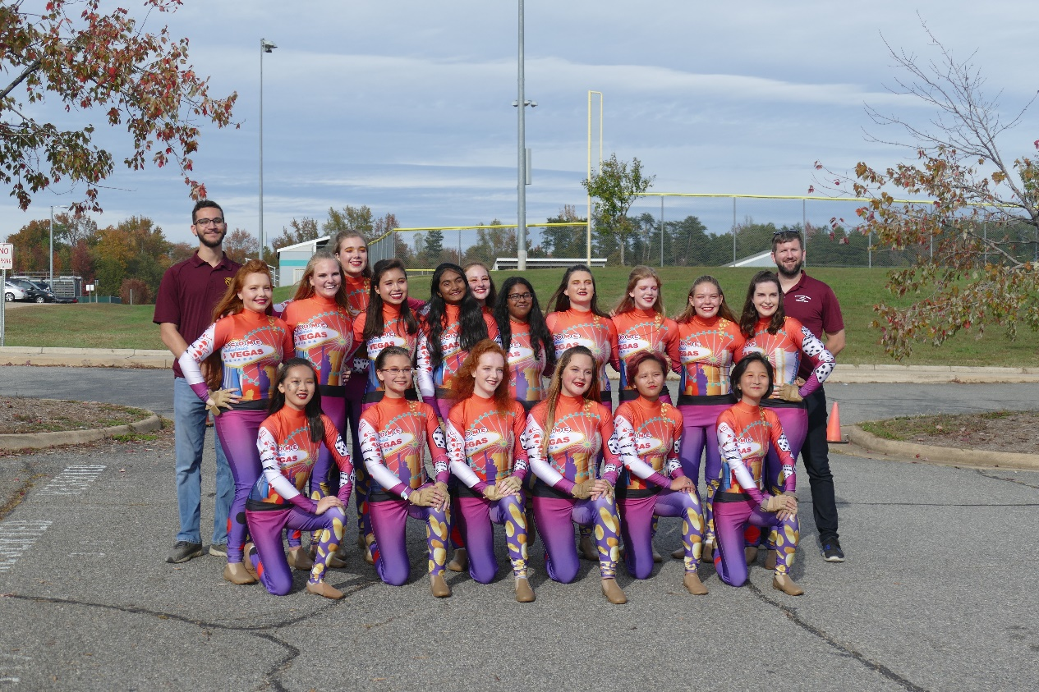
COLOR GUARD
Oakton HS Color Guard 2020

Slide 2
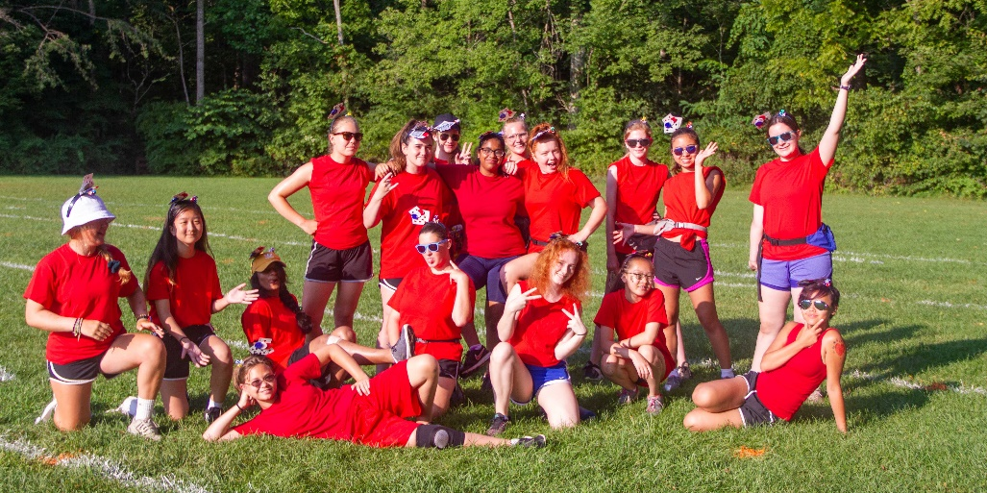
Who are we
Miles Strebeck, color guard/winter guard coach/director
Dr. Van Valkenburg, band director
Sam Gurian, Cristian Contreras, Eli Kaufman, others: Instructors
Parent Coordinators: Jan Ramsey and AnnMarie Campbell
Band members
Band boosters/parents

Slide 3
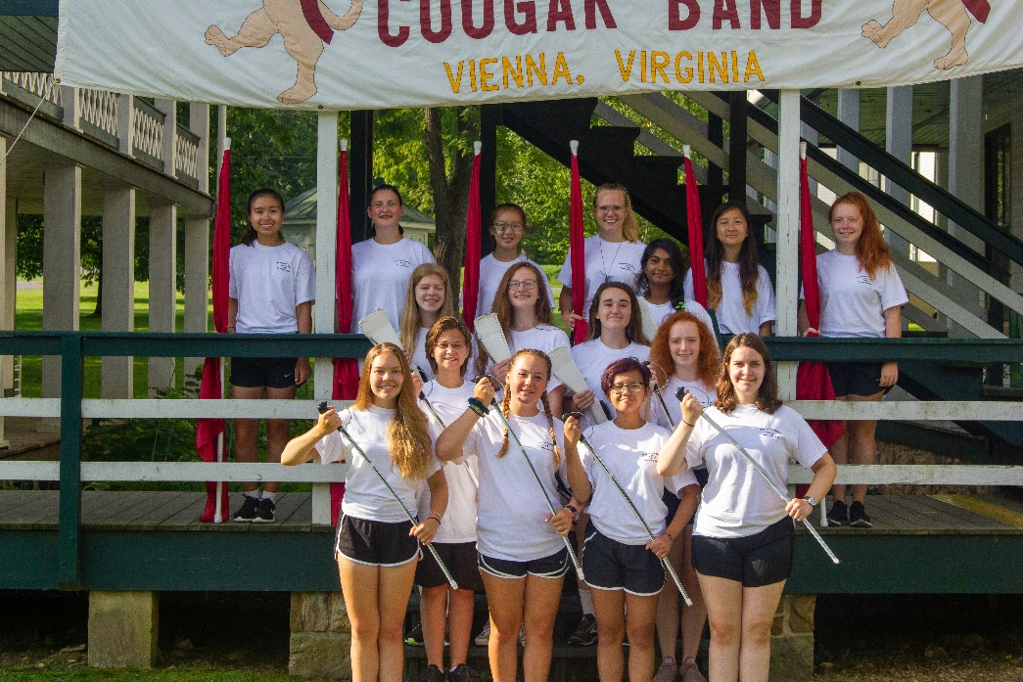
Sport of the arts
Color/Winter Guard is a combination of sport…
Demanding
Endurance
Muscular development to manipulate equipment
Performance
…and art
Pageantry
Exciting
Communicate emotion
Performance

Slide 4
What is it?
We use movement and manipulation of equipment to generate effect
Dance
Spin flag, rifle, and sabre
Set up the stage – use of different formations or “drill”

Slide 5
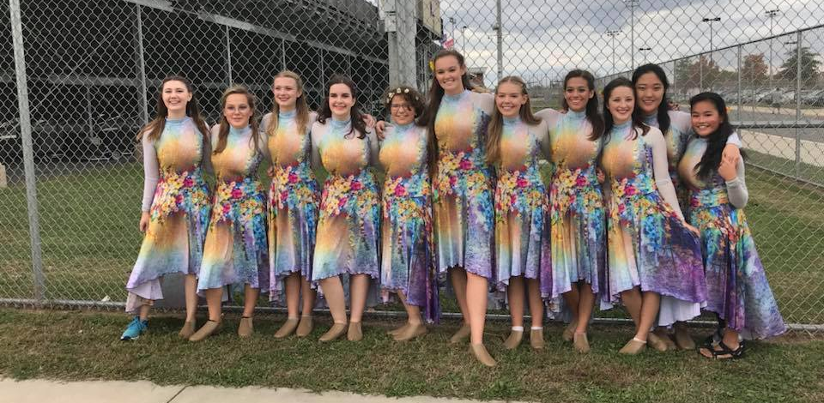
Welcome to Oakton Color Guard
GOAL:
To have a cohesive ensemble that compliments and accentuates the whole marching band

Slide 6
How?
To achieve the goal:
Rehearsals - to put together our program
Individual training – to prepare for rehearsal
Reinforcement – instruction and repetition
Positive atmosphere – we are all learning
Competitions – professional and confident

Slide 7
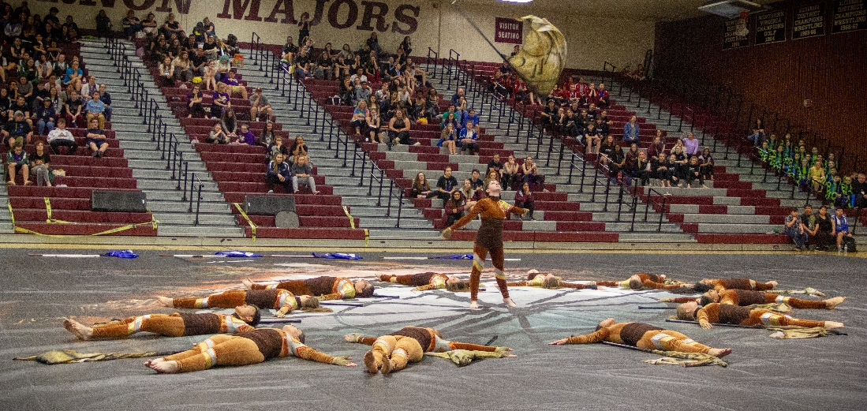
Responsibilities
Attendance at band camp/rehearsal/competitions
Color Guard camp
Band camp – including away camp. Expect all month of August
After school rehearsals – Tu, Th evening 6-8, Wed after school til 5:30
Friday football games – halftime shows
Saturdays competitions in September/October
Calendar is on the band/guard website
Video assignments over summer
Practice on your own
Financial responsibility

Slide 8
Financial responsibility
Marching band fee – see packet
Guard fees – bag, jacket, hair/makeup, misc
We expect members to participate in fundraisers
SCHOLARSHIPS/SPONSORSHIPS ARE AVAILABLE!
Financial concerns should not be a reason to not participate – we can make it work

Slide 9
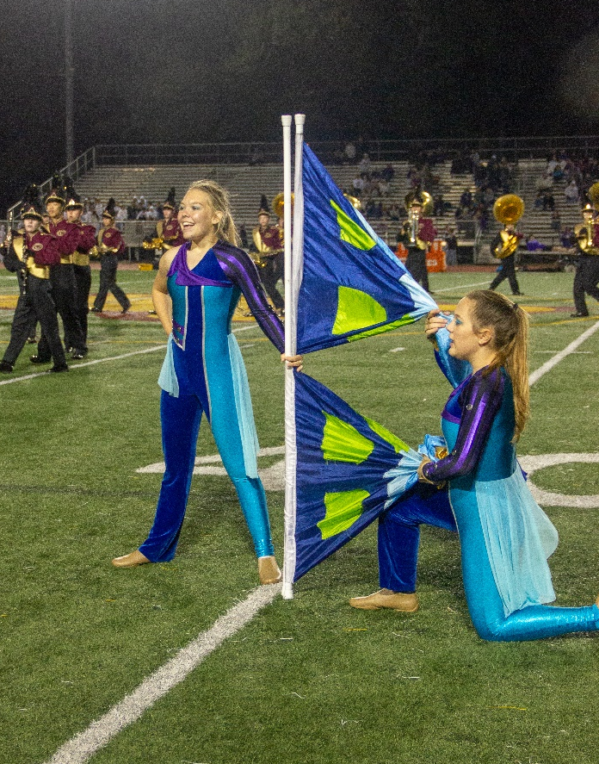
I have more questions…
Some great resources:
WGI.org
Youtube
www.oaktonbands.org
Email Coach at MrStrebeck@fcps.edu

Slide 10
What to do
Check out website at Oaktonbands.org/colorguard
Info on registration
Info on skills
Preview video
Instagram: Oakton_ColorGuard
Twitter: Oakton_Guard

Slide 11
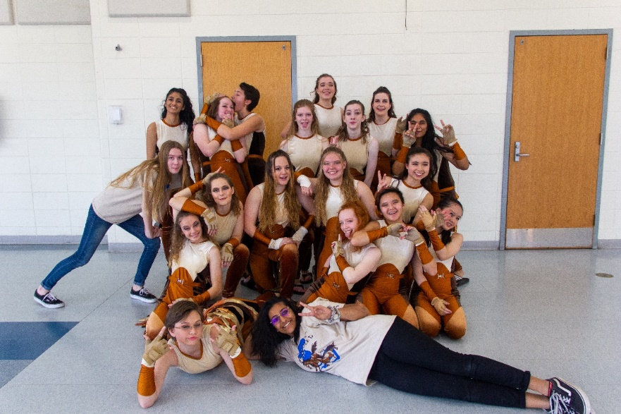
What to do
Virtual Registration is Open!
Forms are available on the Marching Band and Color Guard web pages and the Guard Google Classroom.
Please complete by May 27.
Info for paper forms will come from the band.

Slide 12
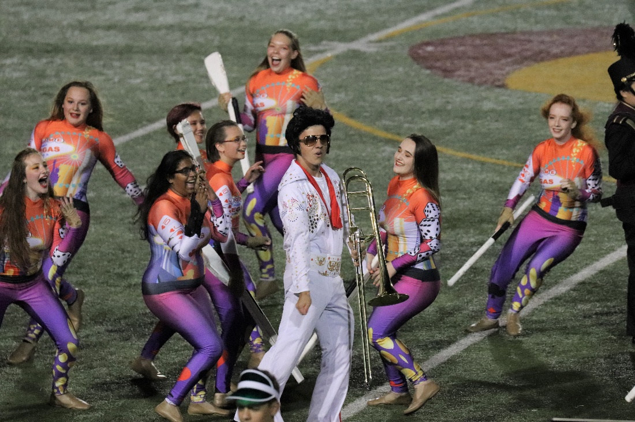
Recruit!
Get A FRIEND!! OR TWO. Or three. Or more
Remember, rising 9th
graders!
Tell your parents –
we need volunteers!

Slide 13
Final things
We are looking forward to an exciting season
But we need your help and participation
Email: MrStrebeck@fcps.edu
Email questions to Coach Strebeck

